Slide 1


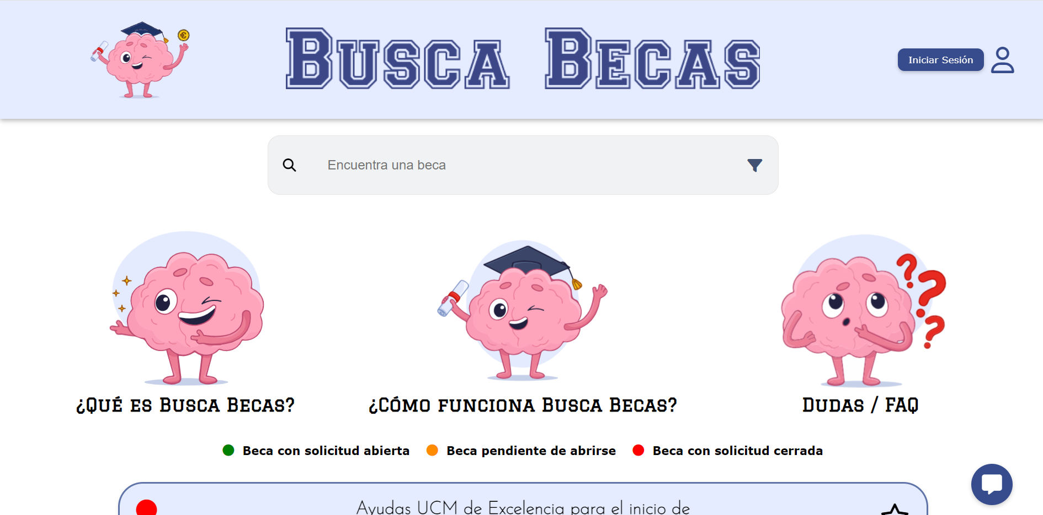
Your scholarship portal in Spain
Daniel Martín, Inés Palero, Laura San Martín
buscabecas.es
Tutor: Ana María González de Miguel

Slide 2





Slide 3



cholarships

Slide 4

Index
01
02
03
04
05
06
Introduction
Technologies
Main features
Architecture
Contributions
Demo

Slide 5

01
Introduction
Motivation & Goals

Slide 6


MOTIVATION
Absence of Comprehensive Platform
Supporting Promising Learner
Information Gap
Enhancing Transparency
According to a study published by EsadeEcPol, 60% of kids in houses with more need don't receive any scholarship, meanwhile 13% of most rich families do.

Slide 7



GOALS
Enjoyable website
Scholarship Awareness
Accessible and Equitable Education

Slide 8

02
Technologies

Slide 9


TECHNOLOGIES: WEB
MySQL
HTML
CSS
JavaScript
PHP
PHPMailer
AJAX
jQuery
Bootstrap
Lottie
Selenium
Beautiful Soup
Python

Slide 10

TECHNOLOGIES: APP
Ionic Framework
Node.js
npm
Angular (NGmodules)
Capacitor Ionic
Apache Cordova
Cordova InAppBrowser Plugin
Cordova Network Information Plugin

Slide 11

03
Main features

Slide 12

FUNCTIONALITIES
VISITOR
User Registration and Login
Search (with filter options)
Search Term Correction
Scholarship Details
Suggestions
Tutorial
FAQ Section
Chat

Slide 13

FUNCTIONALITIES
LOGGED
Notifications
“For you” Filter
Favorites
User Profile & Editing
Reset Password
Scholarship Recommendations
Start an Application
Personality Test
Delete Account

Slide 14
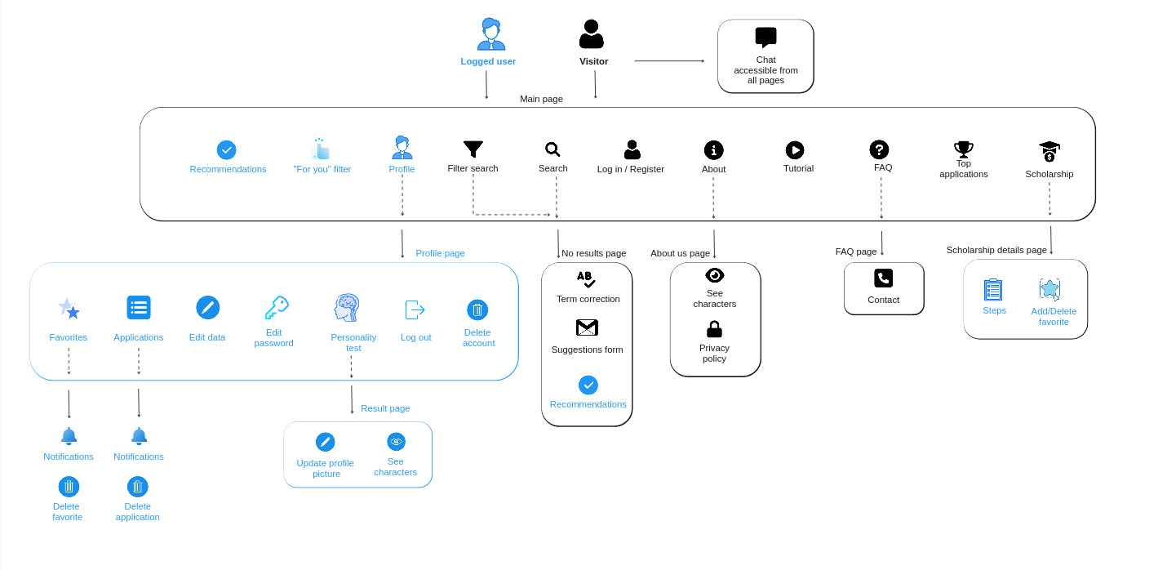
Navigation diagram

Slide 15

04
Architecture

Slide 16
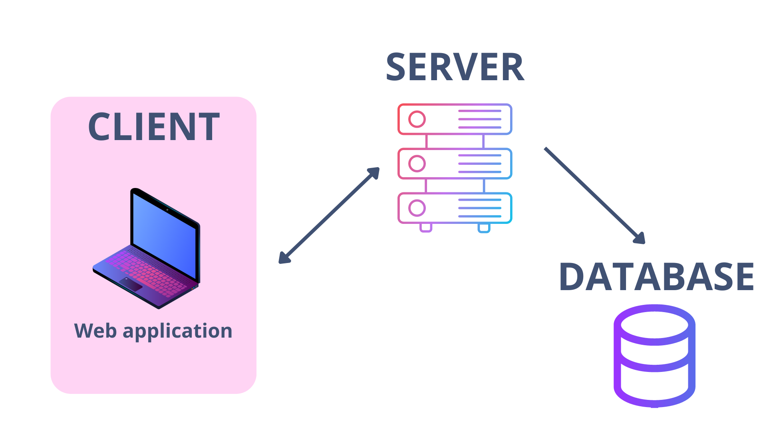
Architecture diagram

Slide 17
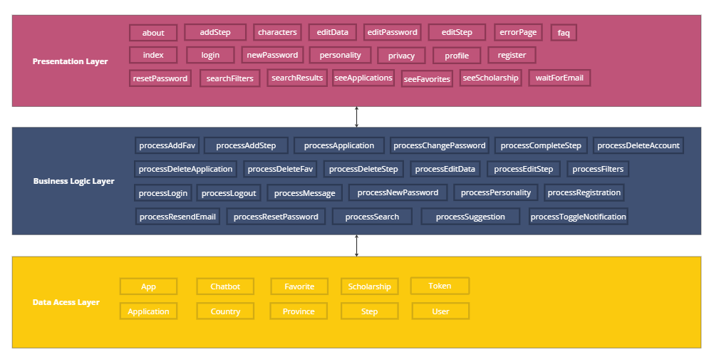
Software architecture

Slide 18

05
Contributions

Slide 19







DANIEL
Interface Design
User Engagement Features
Responsiveness
Scrolling issues
Website Publishing
Mobile Application

Slide 20







INÉS
Chat
Search and filters
Data validation
Email configuration
Web Scraping
Steps

Slide 21







LAURA
Email Notification
Search Term Correction
“For you” filter
Recommendation Features
Token-Based Authentication
Database insertion

Slide 22

06
Demo
WEB

Slide 23


Thank you! Any questions?

